Slide 1
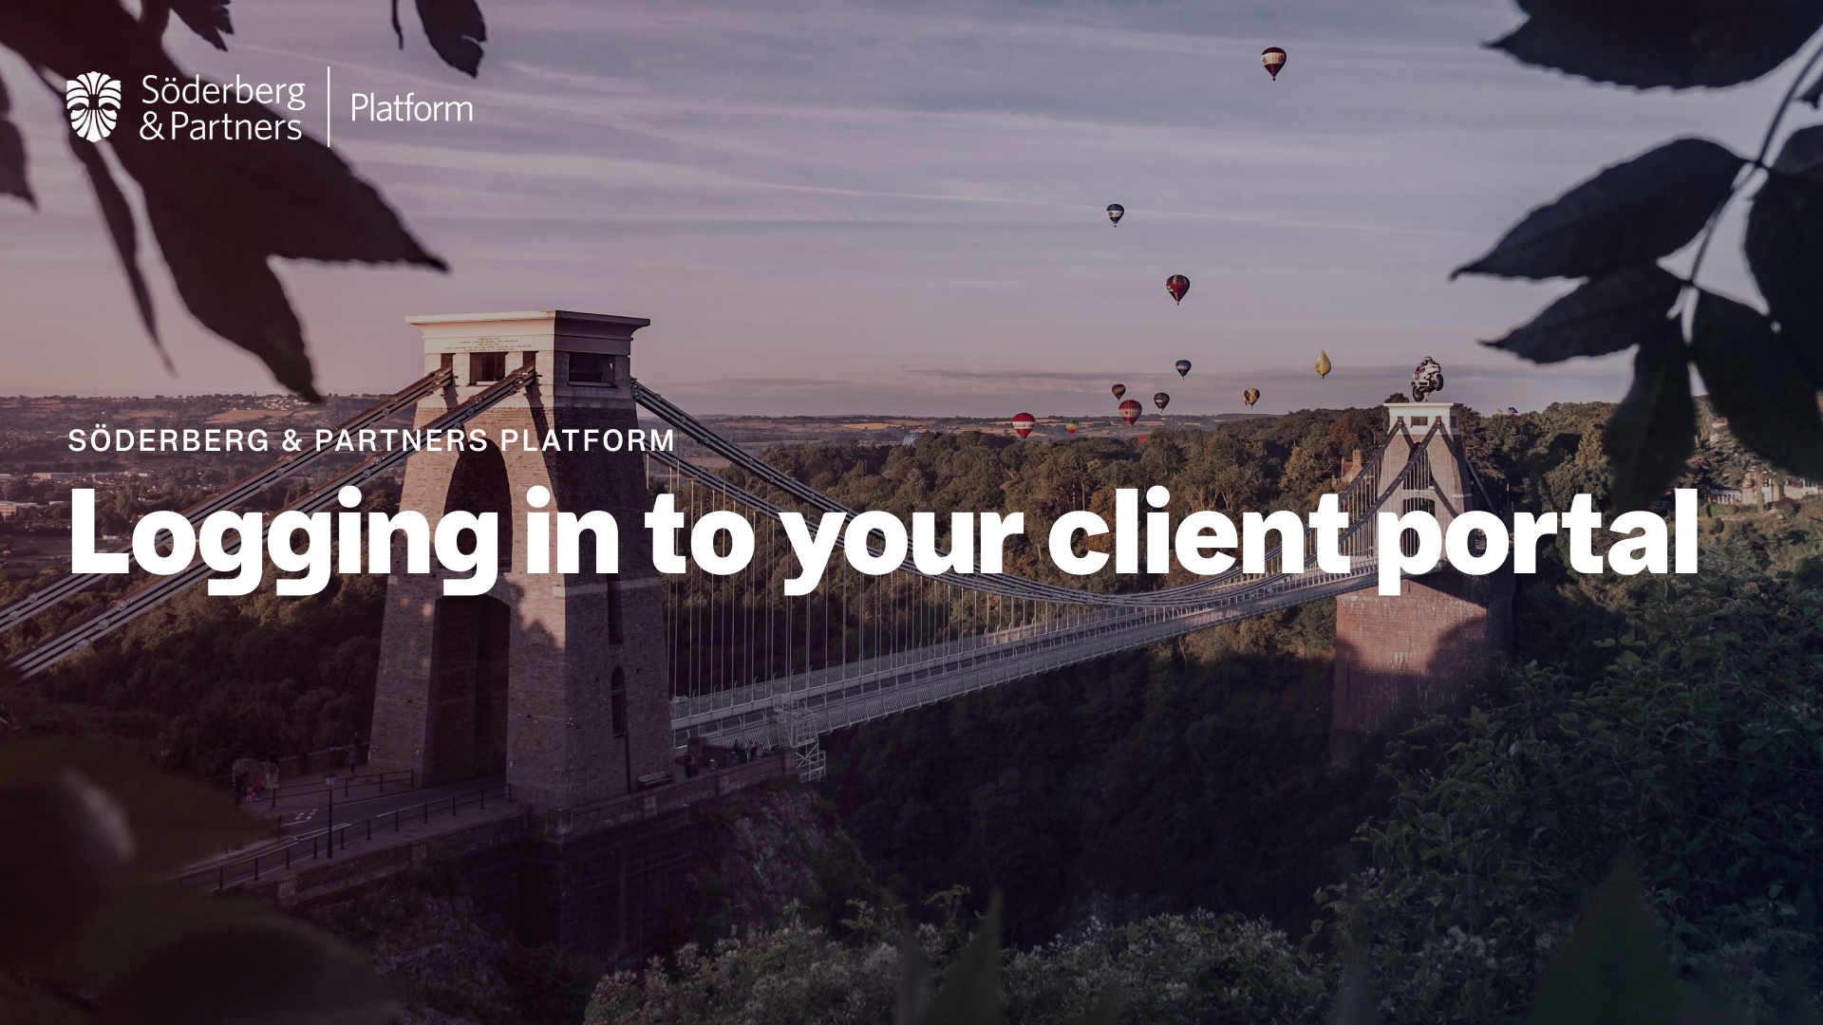

Slide 2
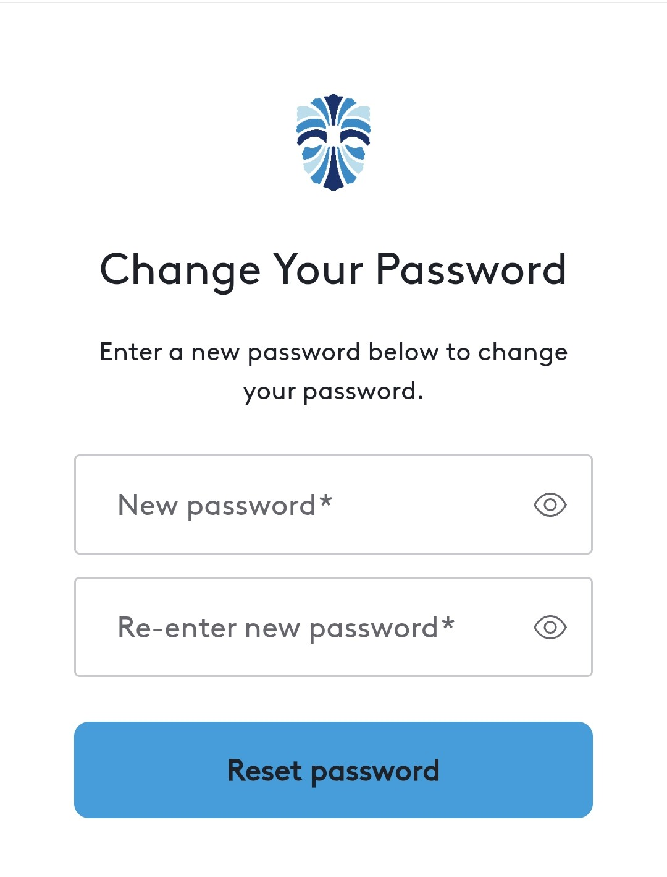
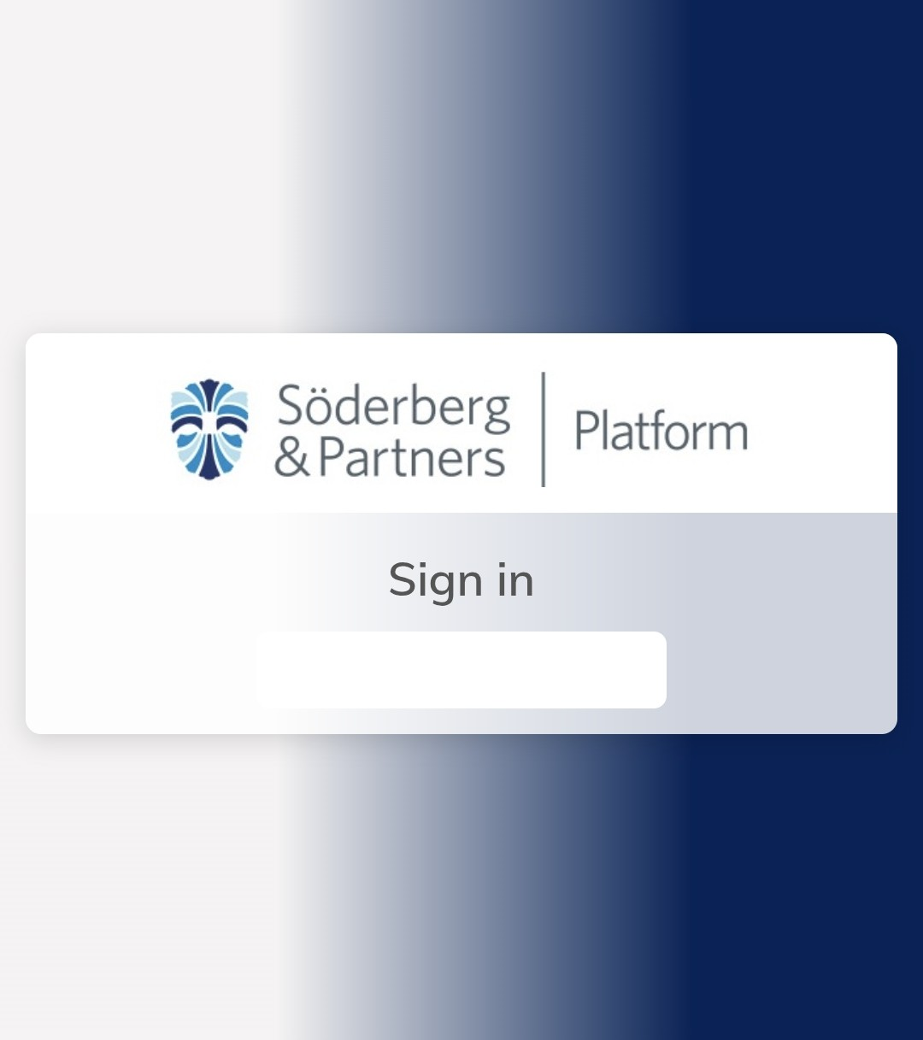
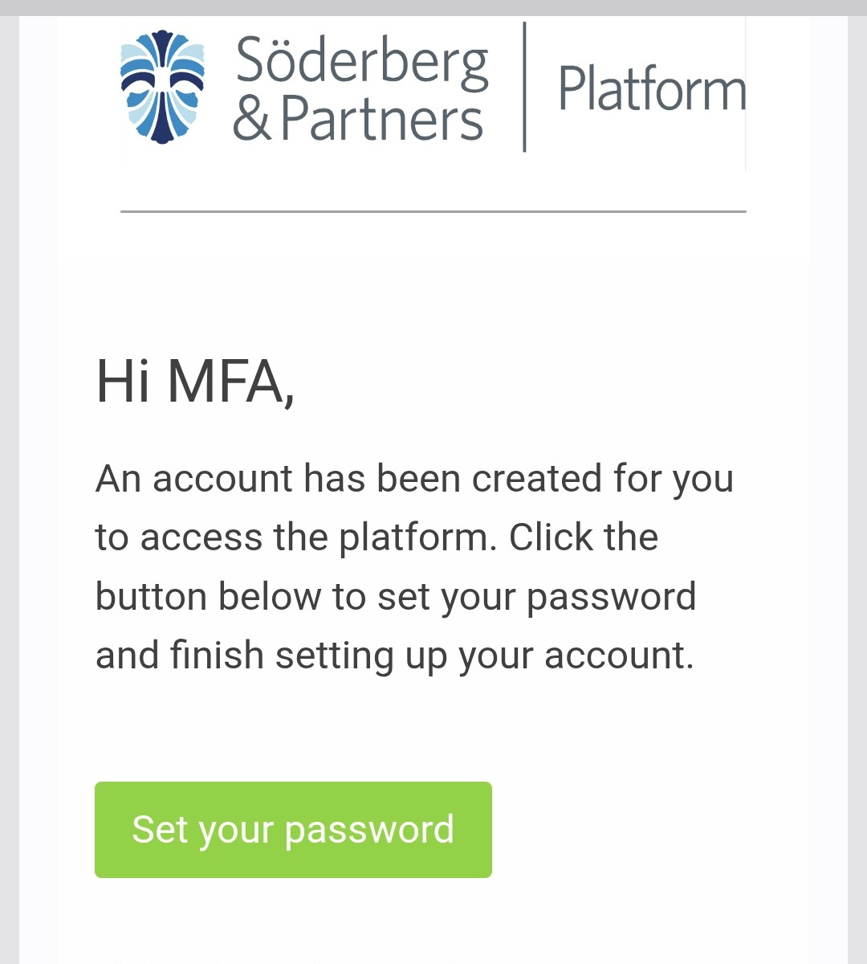

Step 1: Receiving the ‘Set your Password email’
This guide explains how to access your client portal for the first time
If you have received this email, this means your financial adviser has set you up a new client record account on the Soderberg platform.
The first step is to click on the green ‘Set password’ button in your email, as shown below. Please note the link expires after 5 days from date of issue.
If it has been over 5 days since the ‘Set password’ email was received, request a ‘Password reset’ email as this will allow you to create a password. This link expires after 30 minutes.
2. This link will take you through to a web page where you will need to create a password.
3. Once you created your password you will need to sign in.
2

Slide 3
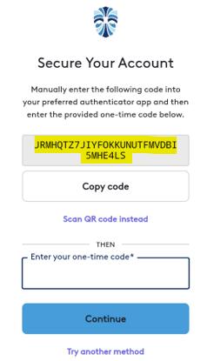
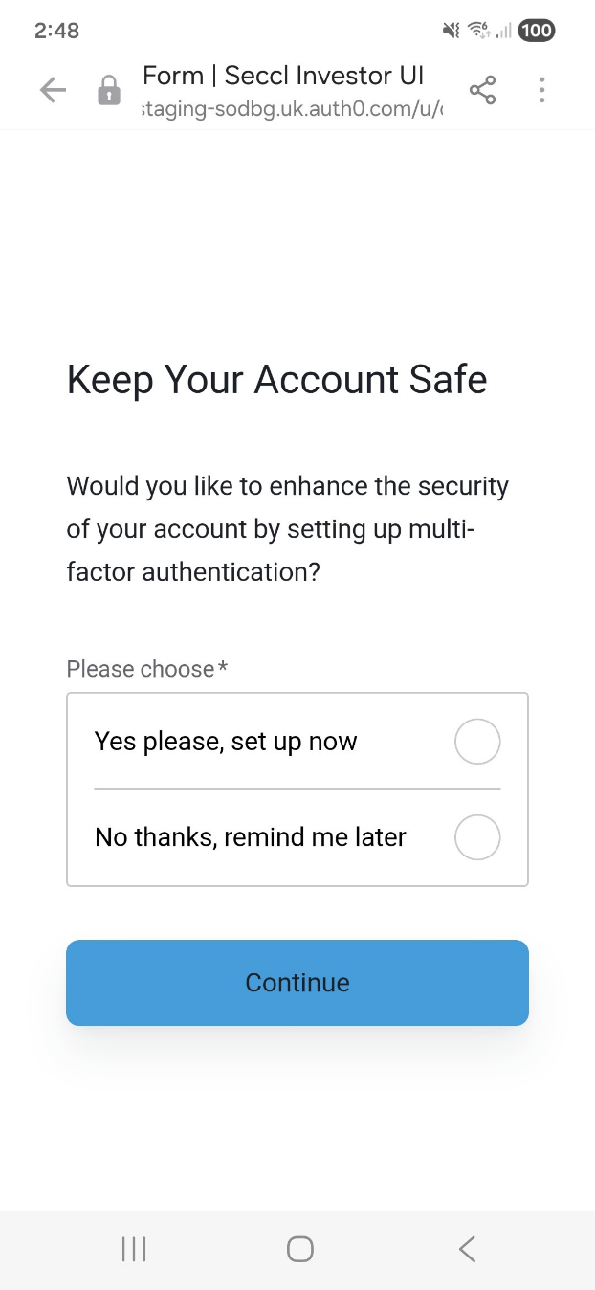
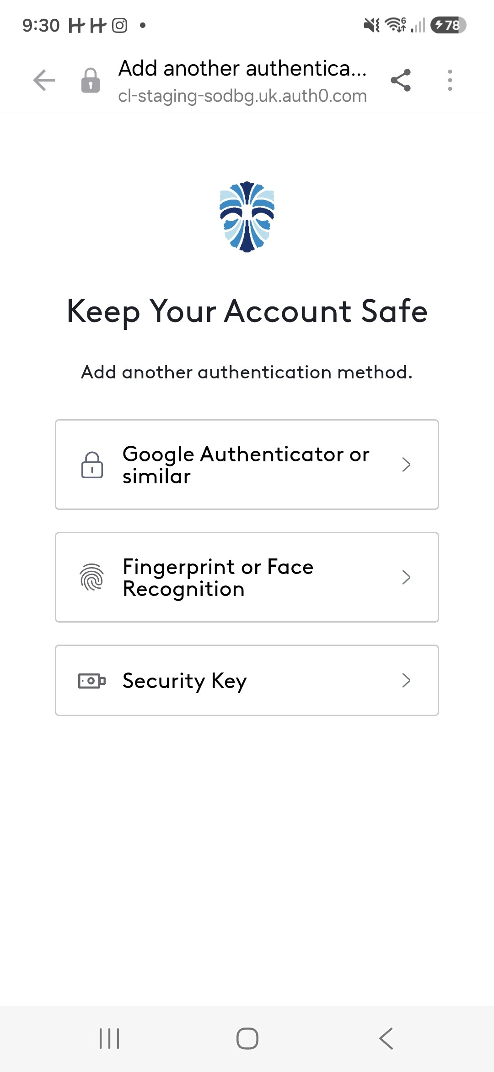

Step 3: Setting up MFA
Google authenticator or similar
Ensure you have Google authenticator or similar downloaded on your device.
Select ‘Google authenticator or similar’ option.
You will be shown the below screen.
Once you have set a password you will be taken to the next screen to set up (Multi Factor Authentication (MFA) as shown below
1. Select either ‘Yes please, set up now’ or ‘No thanks, remind me later’.
If you select ‘Yes please, set up now’, you are taken the screen below where you can choose three ways to authenticate.
Select which of the three you wish to use.
Open ‘Google authenticator or similar’, select the QR code on the bottom right corner.
Enter the code manually and input the code on the screen.
4

Slide 4
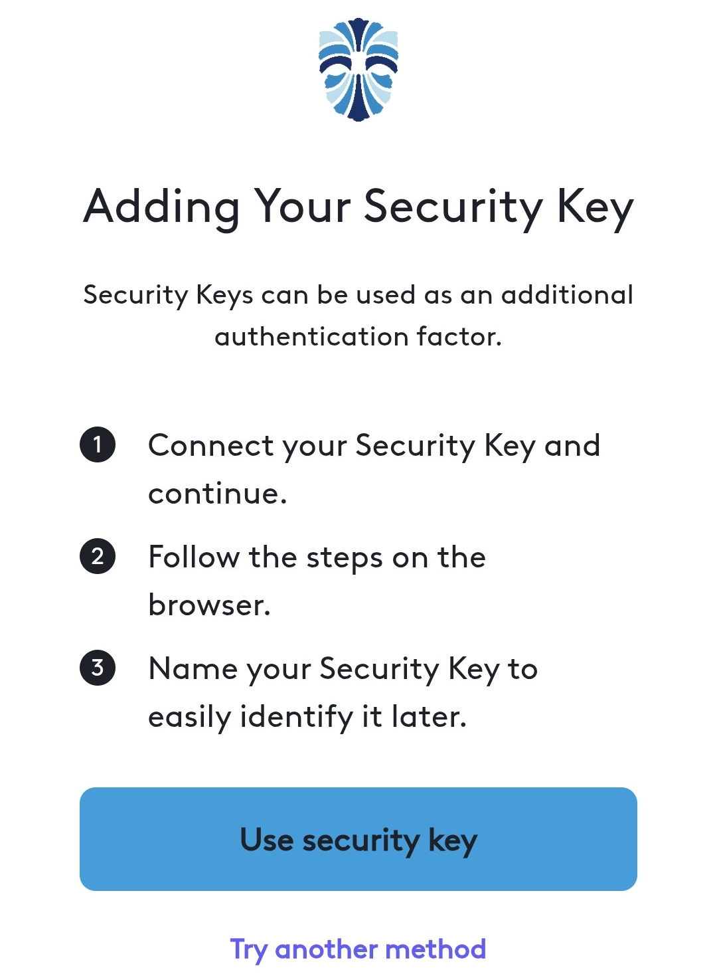
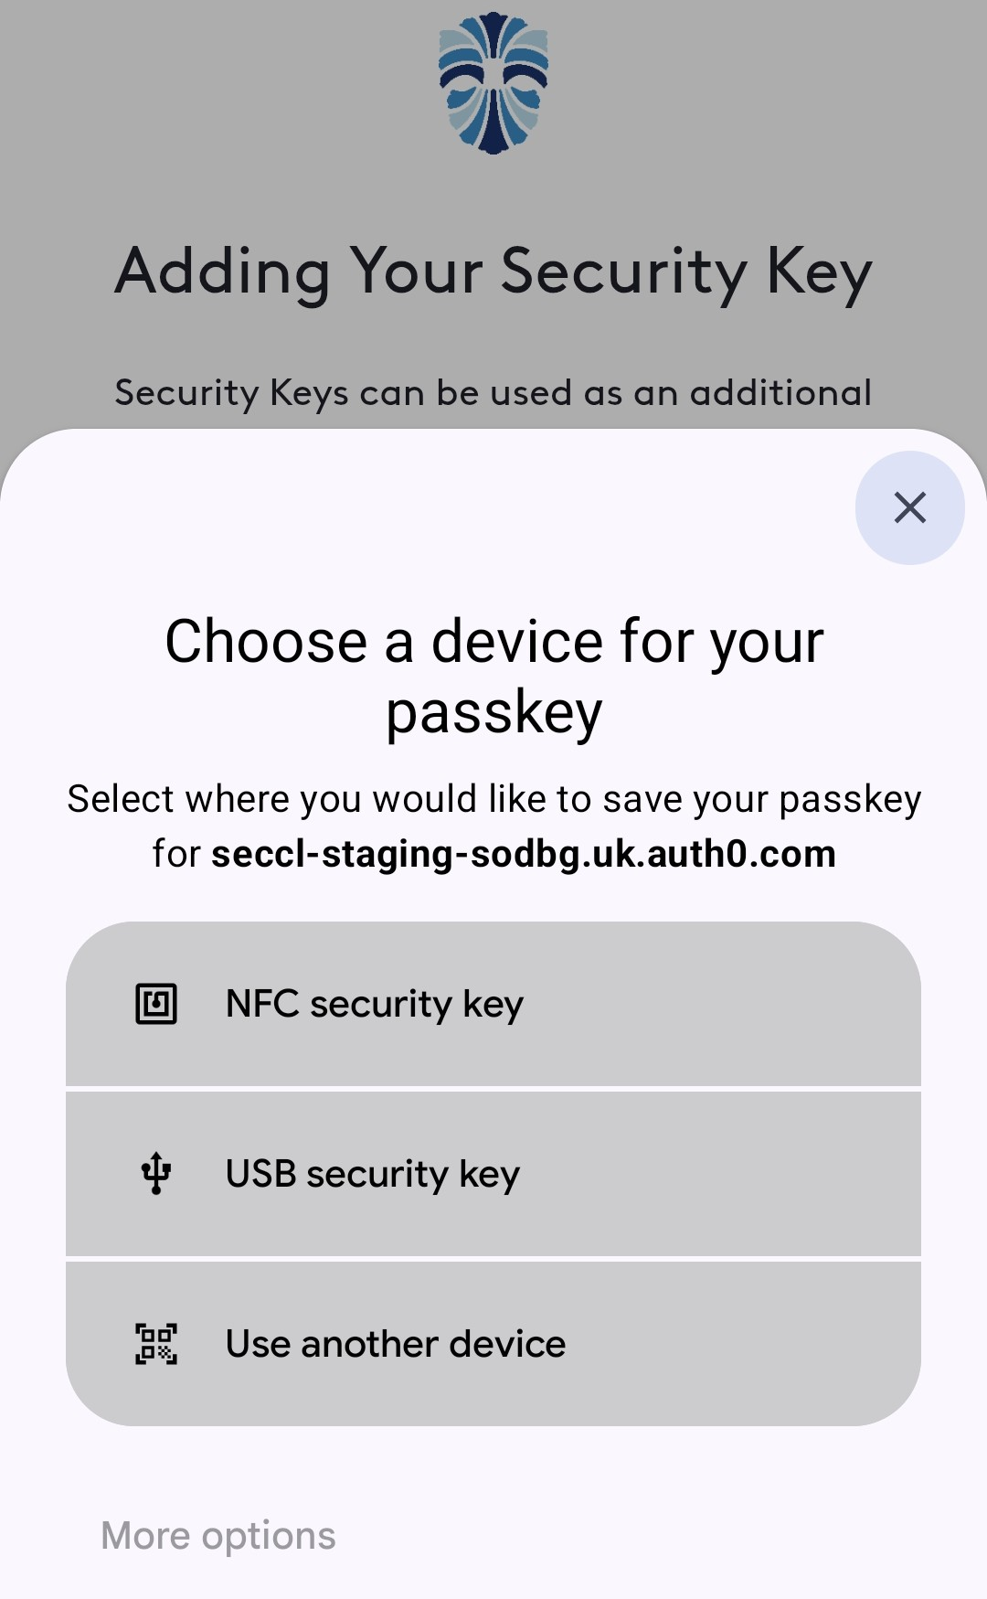
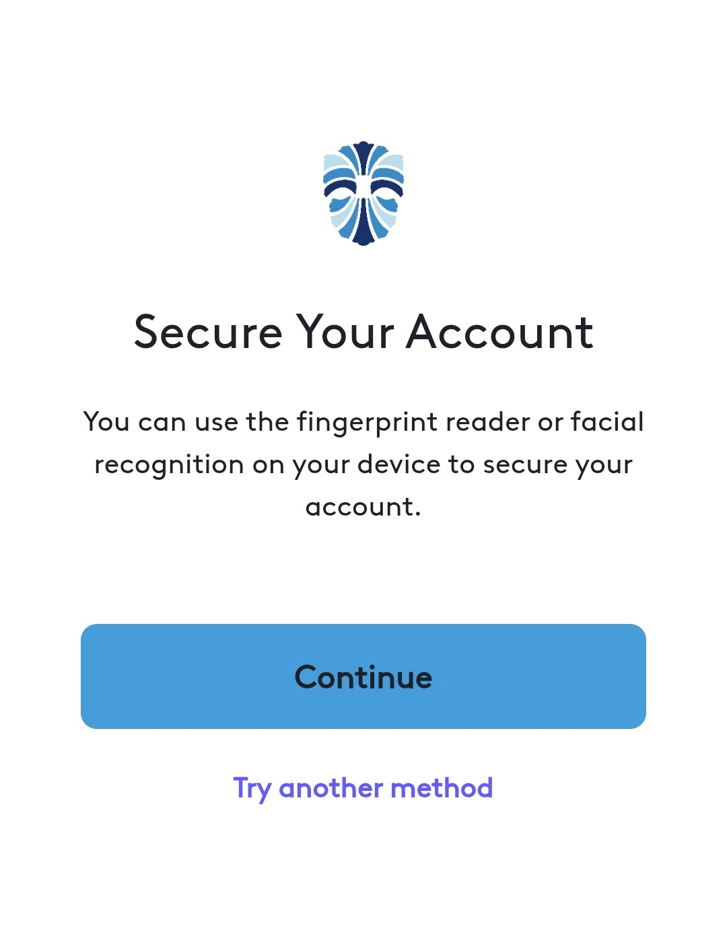
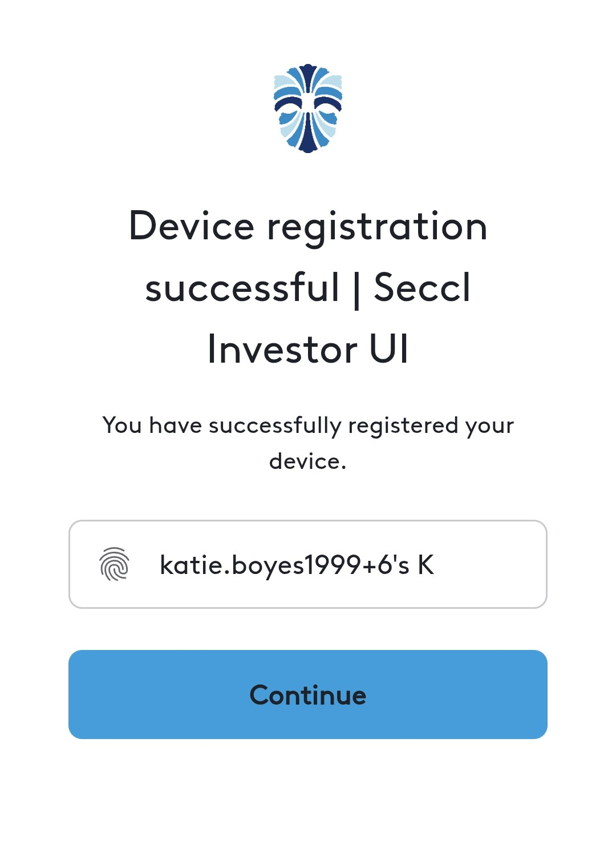
Step 3: Setting up MFA
Security Key
Fingerprint or Face Recognition
You will see the screen shown below, select ‘Continue’.
Whether fingerprint pops up of face recognition appears will depends on your phone settings.
If successful you will see ‘Device registration successful’.
Select ‘Security Key’.
Then select ‘Use security key’ as shown below.
Choose one of the three passkeys and follow the instructions shown on your device.
4. When you have successfully authenticated, you will see the below screen.
5. Select ‘Back to Log in’ and log in as normal and input your email address and password or the platform will log you straight in.
5

Slide 5
Step 3: Setting up MFA
If ‘No thanks, remind me later’ is selected
You will be taken to log in as normal with your email address and password as shown below.
In 30 days, you will receive another prompt as shown here asking you to set up MFA.
Please note MFA is not mandatory
6

Slide 6

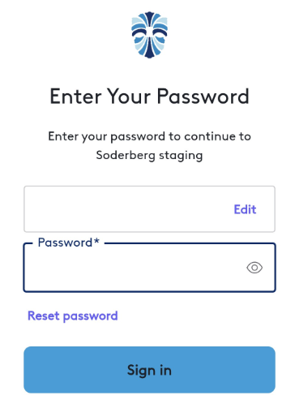
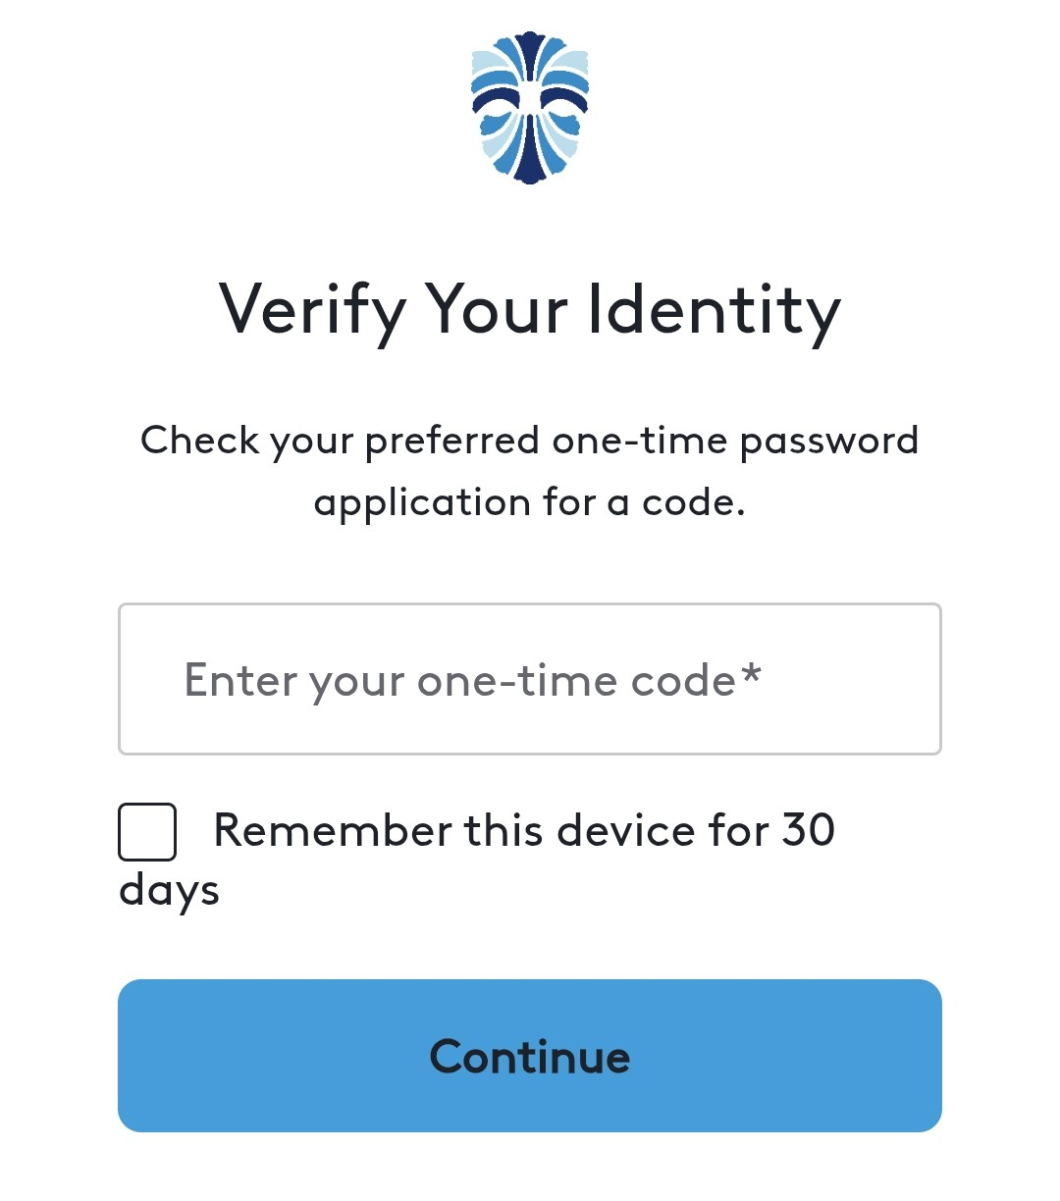
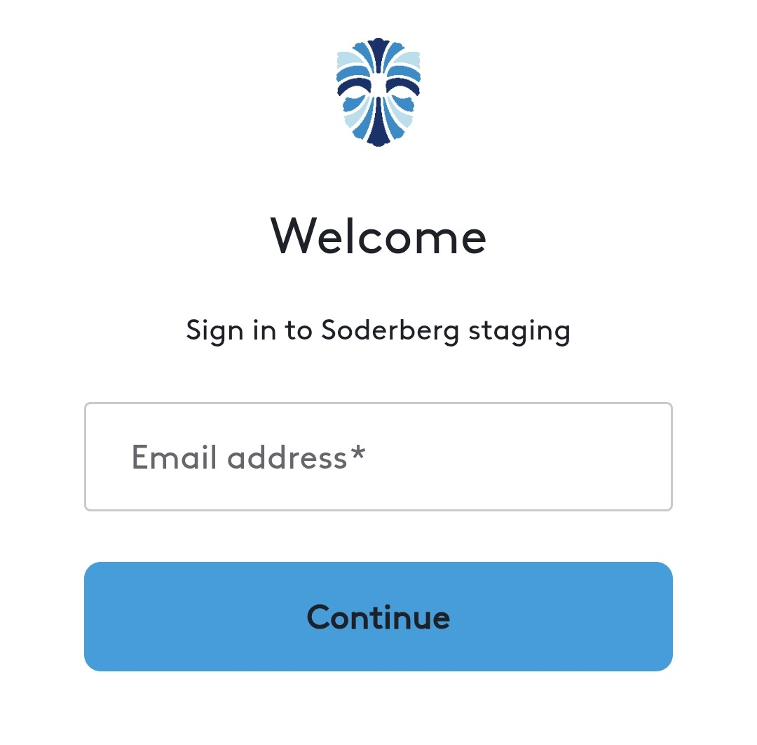

Step 4: Logging in
Navigate to the login page following the prompt to log in after setting up MFA or select no remind me later. You will see the below ‘Sign in’ page.
Enter your email address and password.
Follow the screens on your device as per your selected MFA.
7

Slide 7
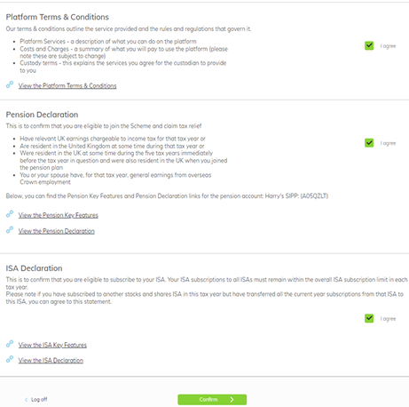
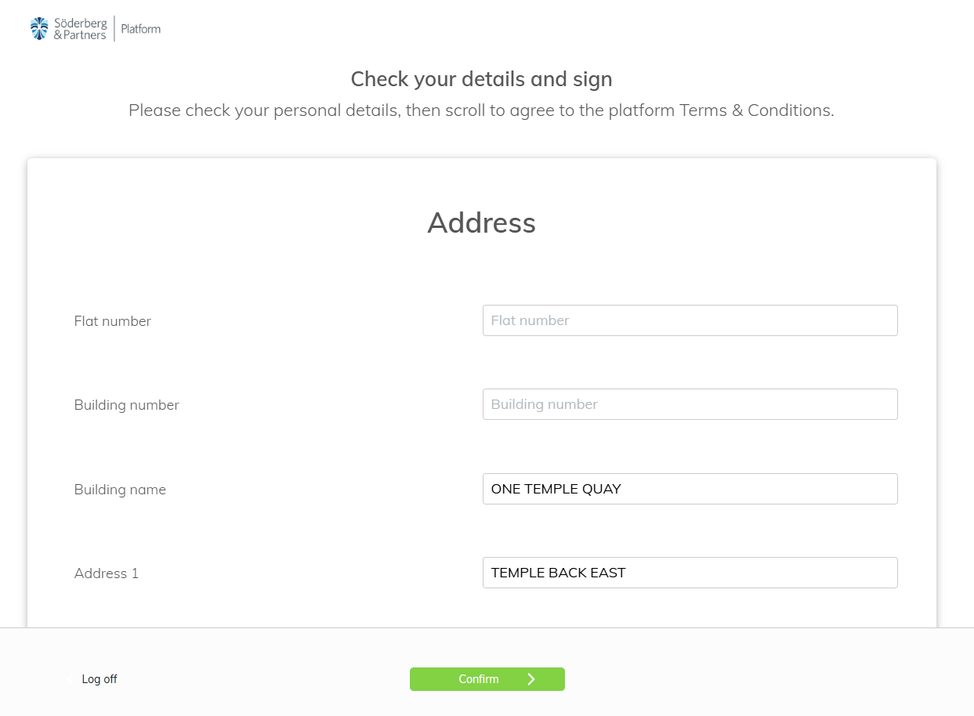
Step 5: Accepting Terms & Conditions and Product Declarations
Scroll down ensuring the information your adviser has input is correct. At the bottom of the first page, you will see the platform Terms & Conditions and Product Declarations to accept, as shown below.
When logging in for the first time, you’ll be taken through to your personal details page. This will look something like this.
3. Tick each box labelled ‘I agree’ to accept the corresponding terms of that section. Then when you are ready click the green ‘Confirm’ button.
Here you will be prompted to enter your bank details if your adviser has not added these to the platform already.
8

Slide 8
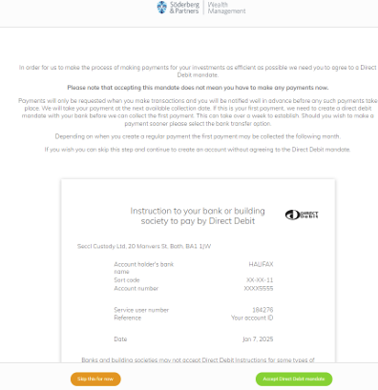
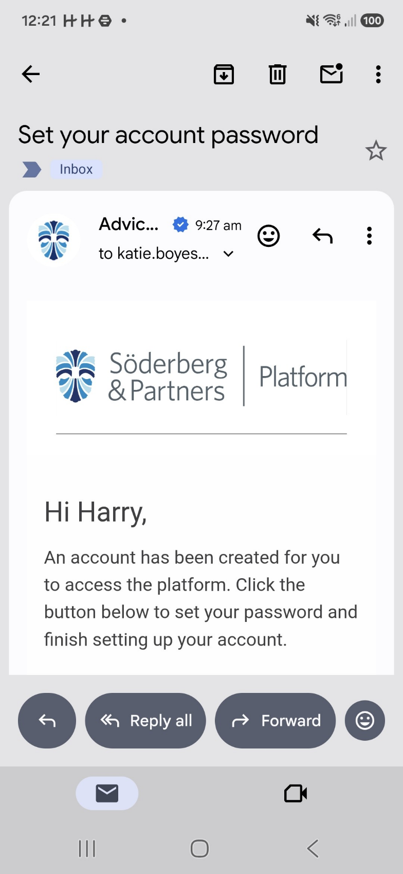
Step 6: Accepting Direct Debit Mandates (if applicable)
Once you have accepted the platform Terms & Conditions and Product Declarations, there maybe a final page for accepting a Direct Debit Mandate.
If you are happy with the info provided on the screen, select ‘Accept Direct Debit Mandate’.
When you have accepted the Direct Debit mandate, you will be taken through into your client portal account.
9

Slide 9
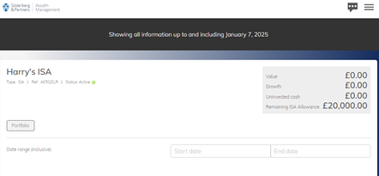
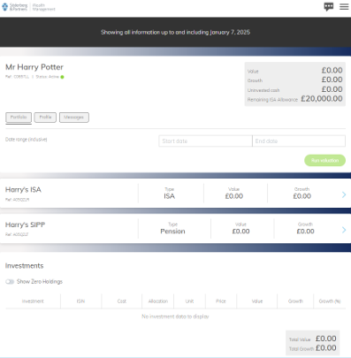
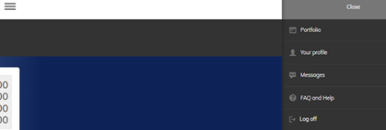
Step 7: Client portal
This is where you can run valuations by setting the dates in the date range section, you can also see a breakdown of investments further down in the ‘Investments’ section.
You can click into each of your accounts.
Here is what your client portal will look like. You will see an overview at the top with ‘Value’, ‘Growth’ and ‘Uninvested cash’.
Lastly, you can view other sections of your client portal account by clicking on the 3-lines icon in the top right-hand corner of the screen.
10

Slide 10
If you have any questions, please feel free to contact our friendly Service Centre team on the contact details below.
Give us a call at +44 117 463 5100 9:00am – 5:00pm (Monday to Friday)
Send us an email servicecentre@soderbergpartners.com

